Slide 1

5. Communicate the results
Notes:
Teacher notes
This session reminds students of the different methods there are to communicate data.
It encourages students to select a method that clearly conveys what the data shows and allows students to test how well they have done this so they can refine as necessary.
If students have not generated results, please use session 4.
This is the fifth of six sessions that work through the problem-solving process. They have been designed to form a basis for a one-hour session, but they can be used flexibly and adapted to suit the needs of your class. The seventh lesson provides further information on entering Google Science Fair.

Slide 2

1
2
3
4
6
7
Identify a problem
Generate ideas
Develop a solution
Design the test
Communicate the results
Draw conclusions
Enter the competition

Slide 3
Session 5: Outline
Checklist Ways to communicate Choosing the right way to communicate In 100 words…? Activity 1: Communication menu Draw it
5 mins 5 mins 15 mins 10 mins 20 mins 5 mins
06 07 08 18 19 20

Slide 4
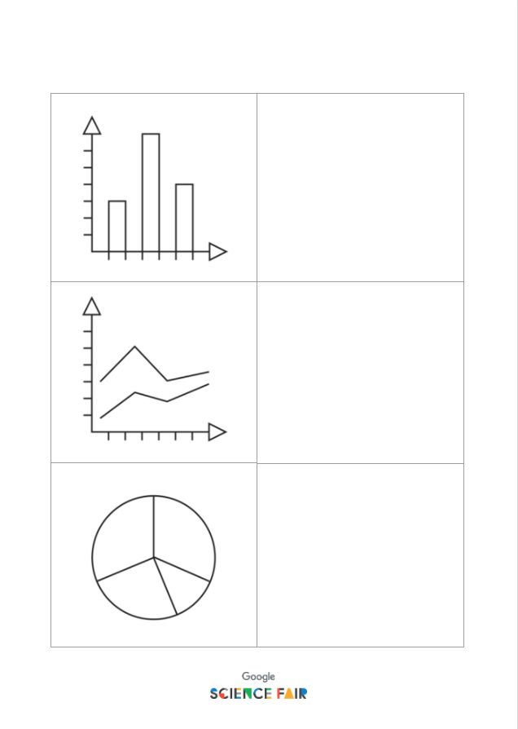
Materials you’ll need
A set of results to analyze or communicate Writing supplies Activity 1: Communication menu

Slide 5

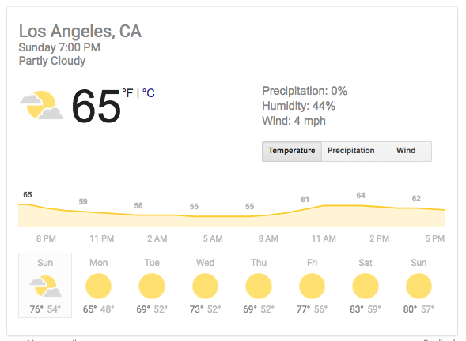
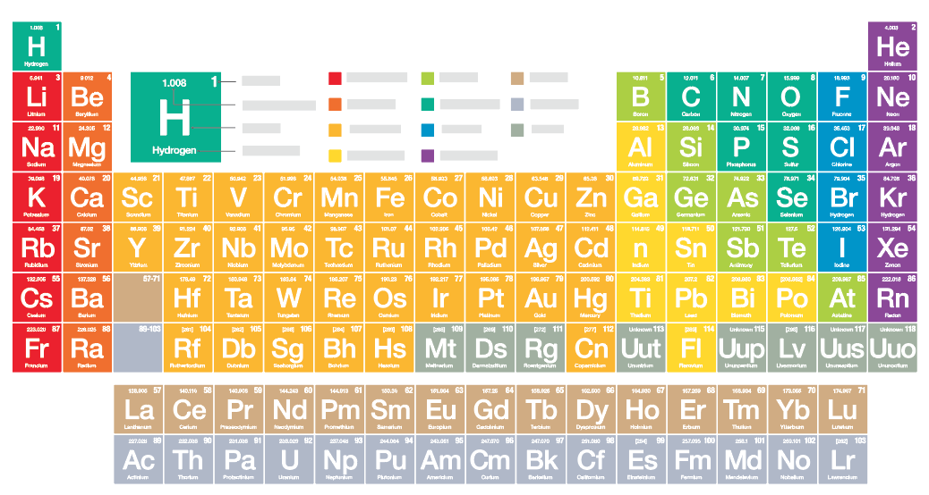
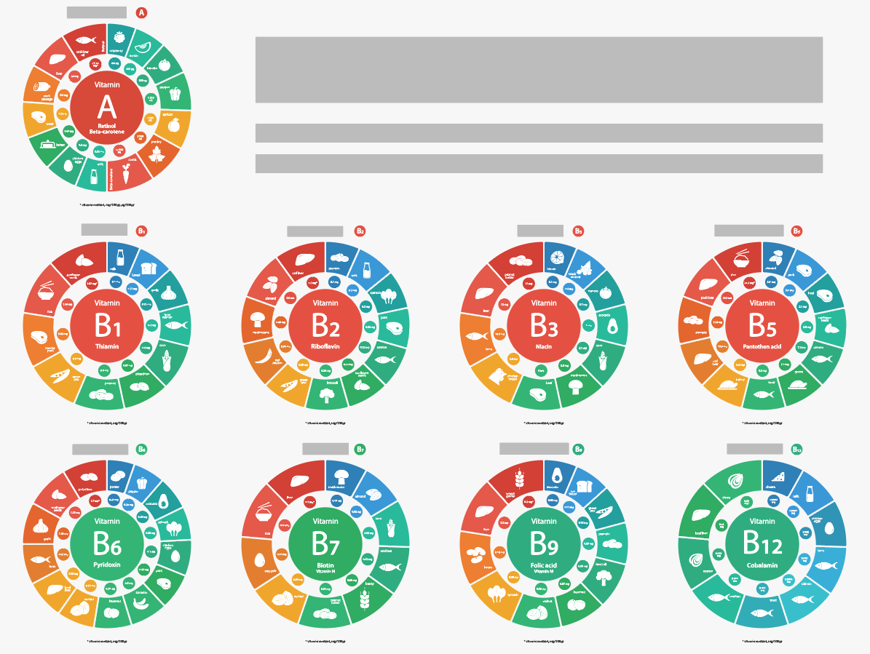
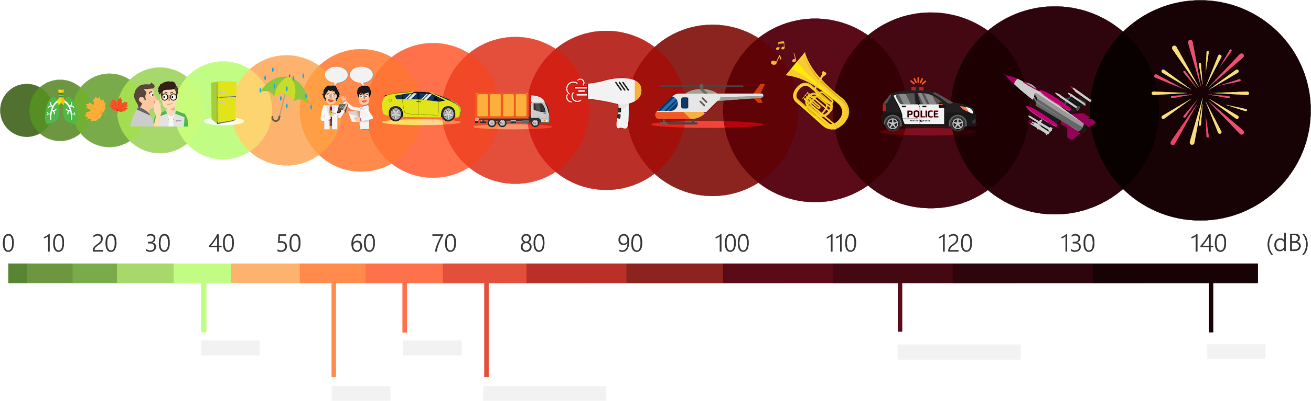
Presenting your results
You’ve designed and tested a solution to your problem and now have results, but how are you going to communicate them?
Notes:
Teacher notes
Explain that there are a number of ways to communicate data.
Ask students what they think all these images have in common? Communication! They all communicate an idea, a concept, some findings, or some data.
Tell students that now that they have their data, this session will help them to identify the best way to communicate it.

Slide 6

Checklist
Is your data accurate? Do you have units of measurement for all your data? Have you verified that calculations (if any) are correct? Can you summarize and explain your results clearly? Do they support your original prediction? If not, can you explain why?
Notes:
Teacher notes
Before starting, use the checklist to ensure students have a clear set of results that are ready to be communicated with an audience.

Slide 7

Things to think about:
What is your key supporting data?
What method will be clearest for your results?
Notes:
Teacher notes
Begin by talking about the importance of sharing results and how they can help to build understanding.
Explain that, depending on their chosen problem, solution and method, students may all have very different data, which will need to be presented in different ways.
Results, findings and data can be overwhelming to take in, but if we communicate in the right way, we can get our message across in a much clearer and more efficient way.
Make sure students are clear on exactly what results or findings they want to present. Note that they must support their solution.

Slide 8
Suggest the best way to communicate the following data…
Notes:
Teacher notes
Students will be shown different data sets. They need to select an appropriate way to communicate the findings.
Hand out Activity 1: Communication menu here to help them if they are struggling to come up with ideas independently.

Slide 9
How would you present this data?
Favorite lesson | Frequency
Math | 6
English | 3
Science | 11
Geography | 9
Physical Edu. | 14
Notes:
Teacher notes
Give students one minute to discuss how they would present this data.
Encourage discussion, take their ideas before showing the suggested data form.
Remind students there will often be more than one appropriate way to present the data, the question is ‘which way works best?’. (This may simply come down to personal preference.)

Slide 10
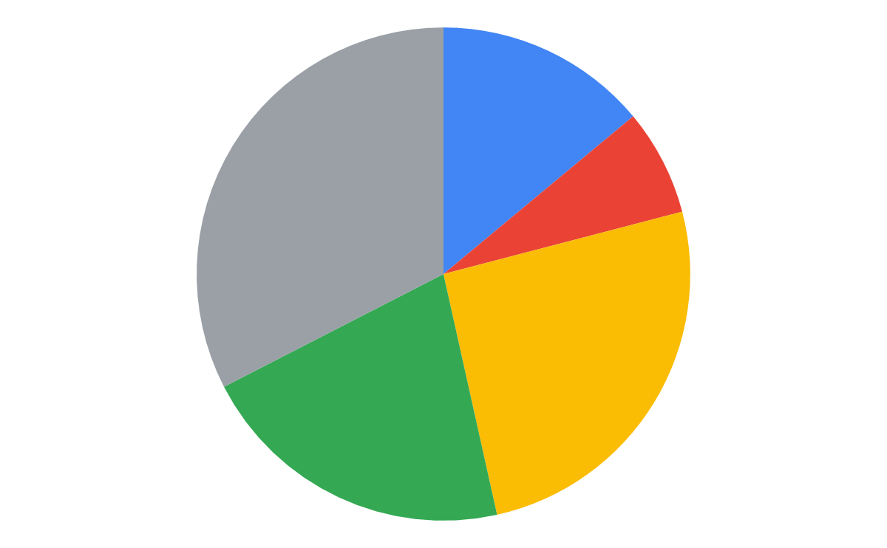
How would you present this data?
Favorite lesson
Math 14%
Favorite lesson | Frequency
Math | 6
English | 3
Science | 11
Geography | 9
Physical Edu. | 14
English 7%
Physical Edu. 32.6%
Science 25.6%
Geography 20.9%
Why couldn’t you use a line graph to represent this? What other type of graph could you use here?
Notes:
Teacher notes
Introduce the idea of continuous and discontinuous data.
A line graph cannot be used for data that doesn’t have discrete categories.
A suitable alternative would be a bar graph.

Slide 11
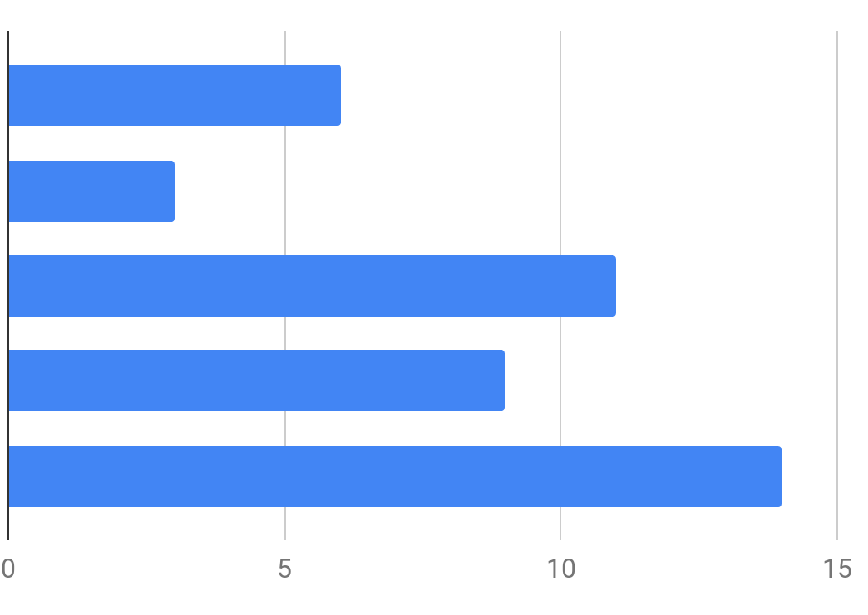
How would you present this data?
Favorite lesson
Favorite lesson | Frequency
Math | 6
English | 3
Science | 11
Geography | 9
Physical Edu. | 14
Math English
Science
Geography
Physical Edu.
Which works better: Pie chart? Bar graph? Why?
Notes:
Teacher notes
Encourage students to argue why they feel one way of graphing is better than the other:
Is one easier to read?
Why?
What importance does color have in graphing?
Are the specific numbers important, or the trend?
Are you looking to give a snapshot/overview or finer details?
This will impact the type of graph they choose.

Slide 12
What type of graph would you choose to communicate this data?
Favorite lesson | Frequency (Girls) | Frequency (Boys)
Math | 6 | 8
English | 3 | 1
Science | 11 | 10
Geography | 9 | 5
Physical Edu. | 14 | 19
Notes:
Teacher notes
What type of graph could you use to communicate this data?

Slide 13
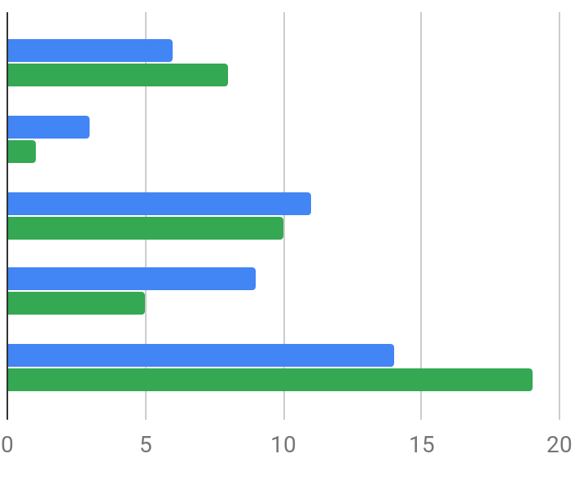
What type of graph would you choose to communicate this data?
Favorite lesson
Favorite lesson | Frequency (Girls) | Frequency (Boys)
Math | 6 | 8
English | 3 | 1
Science | 11 | 10
Geography | 9 | 5
Physical Edu. | 14 | 19
Girls Boys
Math English
Science
Geography
Physical Edu.
Why does a pie chart not work so well now?
Notes:
Teacher notes
Ask students why a pie chart wouldn’t work here.
Explain that you want to compare two different data sets, which isn’t possible with a pie chart - this starts to limit the graphing options you have.
How much data do students want to show from their own findings?

Slide 14
How could you effectively communicate the best sellers at a fast food restaurant?
Item | # bought in one hour
Burger | 12
Hot dog | 5
Sandwich | 16
Fries | 36
Soda | 25
Ice cream | 8
Notes:
Teacher notes
Ask students how they would communicate this data.

Slide 15

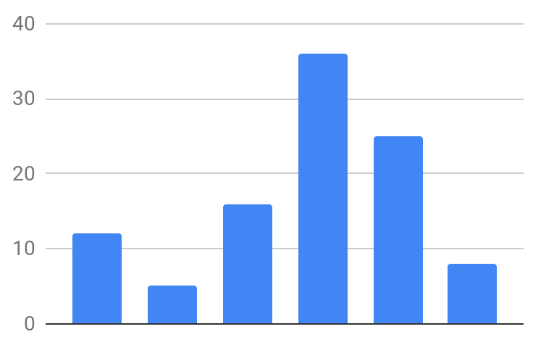





How could you effectively communicate the best sellers at a fast food restaurant?
Item | # bought in one hour
Burger | 12
Hot dog | 5
Sandwich | 16
Fries | 36
Soda | 25
Ice cream | 8
Foods bought in one hour
Notes:
Teacher notes
Show students these options. Ask:
Which method works better?
Why?
What’s the aim of the test - what are you trying to show?
This may impact the graphing method you choose.

Slide 16
How would you present this data?
Car type | Pollutant levels in ppm
 | 12am | 2am | 4am | 6am | 8am | 10am | 12pm | 2pm | 4pm | 6pm | 8pm | 10pm
Petrol | 186 | 78 | 60 | 228 | 864 | 1085 | 784 | 251 | 384 | 810 | 410 | 202
Diesel | 305 | 157 | 106 | 458 | 1867 | 2894 | 894 | 356 | 398 | 1864 | 845 | 359
Hybrid | 41 | 25 | 23 | 108 | 253 | 359 | 205 | 158 | 233 | 286 | 128 | 62
Notes:
Teacher notes
Show students this data table.
Ask what they see as a challenge in presenting it.
Elicit from students that there are three datasets we want to compare.
Ask students how they might present this data.

Slide 17
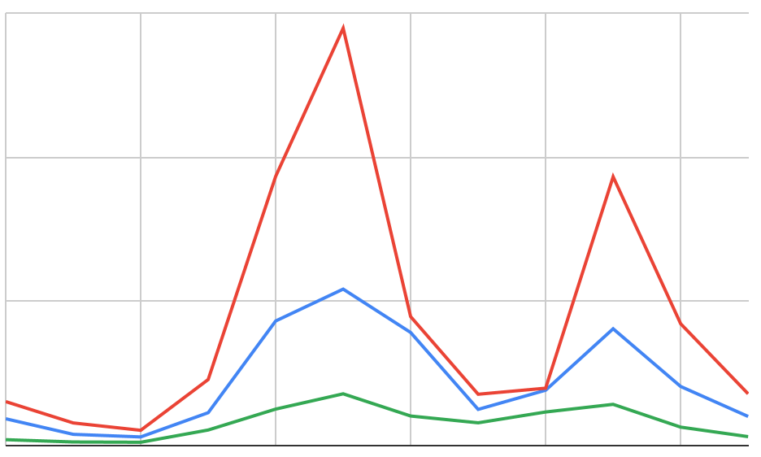
How would you present this data?
Car pollutant levels (ppm) over 22 hours
3000
2000
1000
0 ppm
Petrol Diesel
Hybrid
12AM 4AM 8AM 12PM 4PM 8PM 10PM
Notes:
Teacher notes
Show students the line graph.
Line graphs are a good way to identify and communicate trends or patterns - do any of them have trends in their data?
Emphasize the importance of colors in comparing data to help clearly communicate the difference.

Slide 18

Communicate your findings in 100 words.
Notes:
Teacher notes
Ask students to write a 100-word summary of their results. What do they want their audience to understand from the data?
This will help students reflect and focus on the key idea they wish to communicate and put them in a better position to choose the best technique to show their findings.

Slide 19
Activity 1: Communication menu
Communicate your data
Use the Communication menu to help if you need.
Notes:
Teacher notes
Give students the Activity 1: Communication menu to help them select the best method to communicate their data.
Help students to graph their data where necessary.

Slide 20

How well has your data been communicated?
Pair up with someone else and swap graphs.
Each person should write a short summary on the graph they now have in front of them (max. 100 words).
Swap back so you have your graph back.
Compare the summary that your partner has written with the one you wrote earlier on.
Does the graph succeed at communicating the idea you intended?
Refine if necessary!
Notes:
Teacher notes
Tell students this is a test to show how well their data has been communicated.
In pairs, they are going to look at each other’s graphs and see if they have communicated what they intended to.
Encourage students to use this exercise to add to/alter/amend their graph.
They can repeat the process until they are sure their message is communicated effectively.

Slide 21
Now that you have your results, it’s time to form a conclusion!
Session 6: Draw conclusions

